Slide 1
Multi-Agent A3C
By: Mohammed Deifallah
Reinforcement Learning - Seminar 4

Slide 2
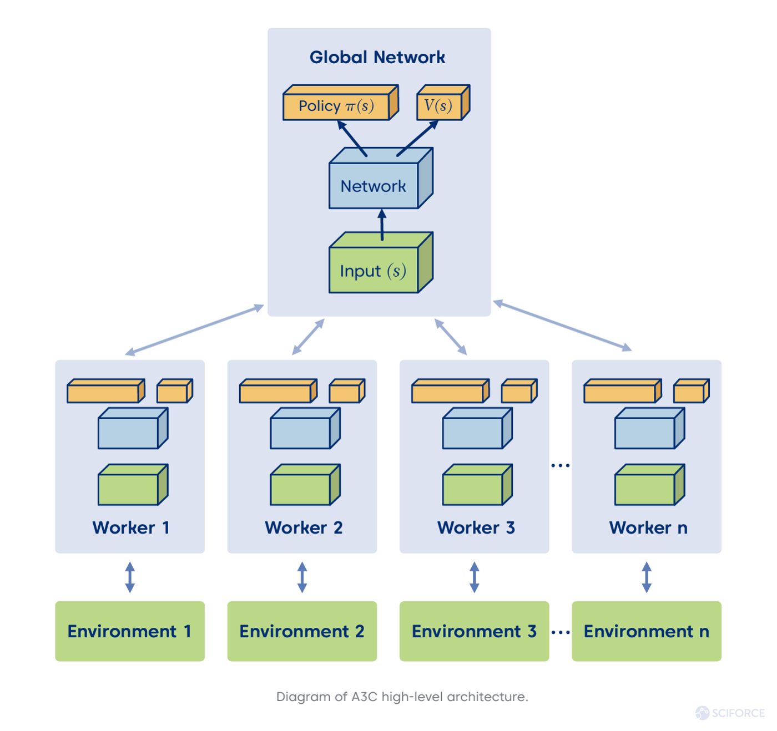
Introduction
Source: https://tinyurl.com/339u2cxs

Slide 3
Introduction
Sequel to A2C by DeeMind
Asynchronous
Advantage
Actor-Critic
Source: https://arxiv.org/pdf/1602.01783.pdf

Slide 4
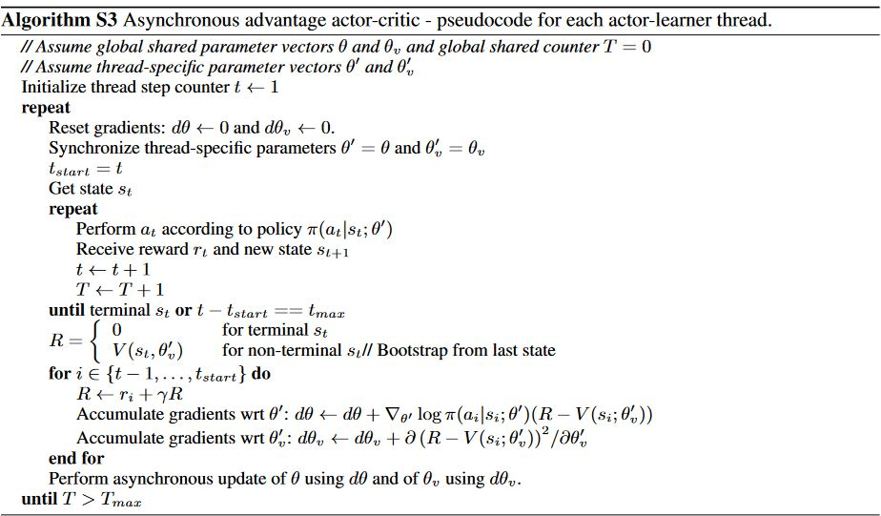
Algorithm

Slide 5
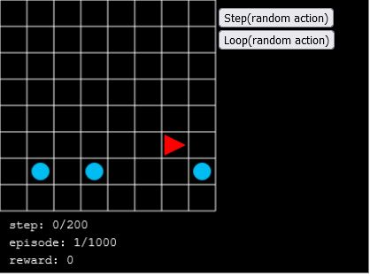
Results
Source: https://tinyurl.com/55mt6xv8

Slide 6
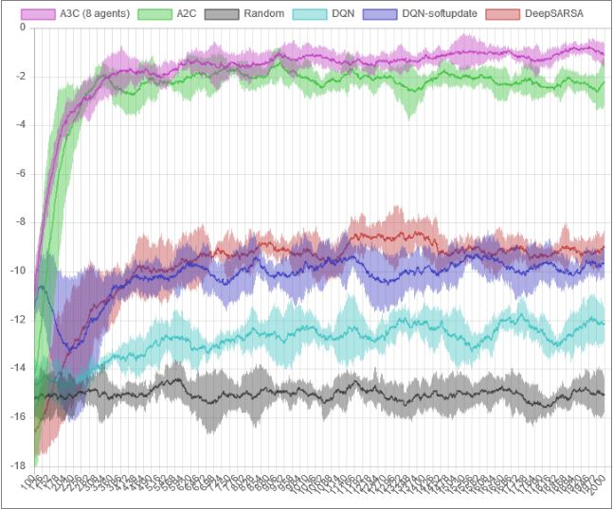
Results
Source: https://tinyurl.com/whv8cerj

Slide 7
Advantages
Speed and Scalability
Diversification of Knowledge
DT vs. CT

Slide 8

Drawbacks

Slide 9
Thanks!

